Slide 1
Matrix Multichain Unity ToolKit
For Unity Game Developers

Slide 2
It’s time to Move your browser based games to Web3
transition to Web3 as simple as it’s a piece of cake
image source: https://www.badgehungry.com/2018/06/23/new-other-game-sites-list/

Slide 3


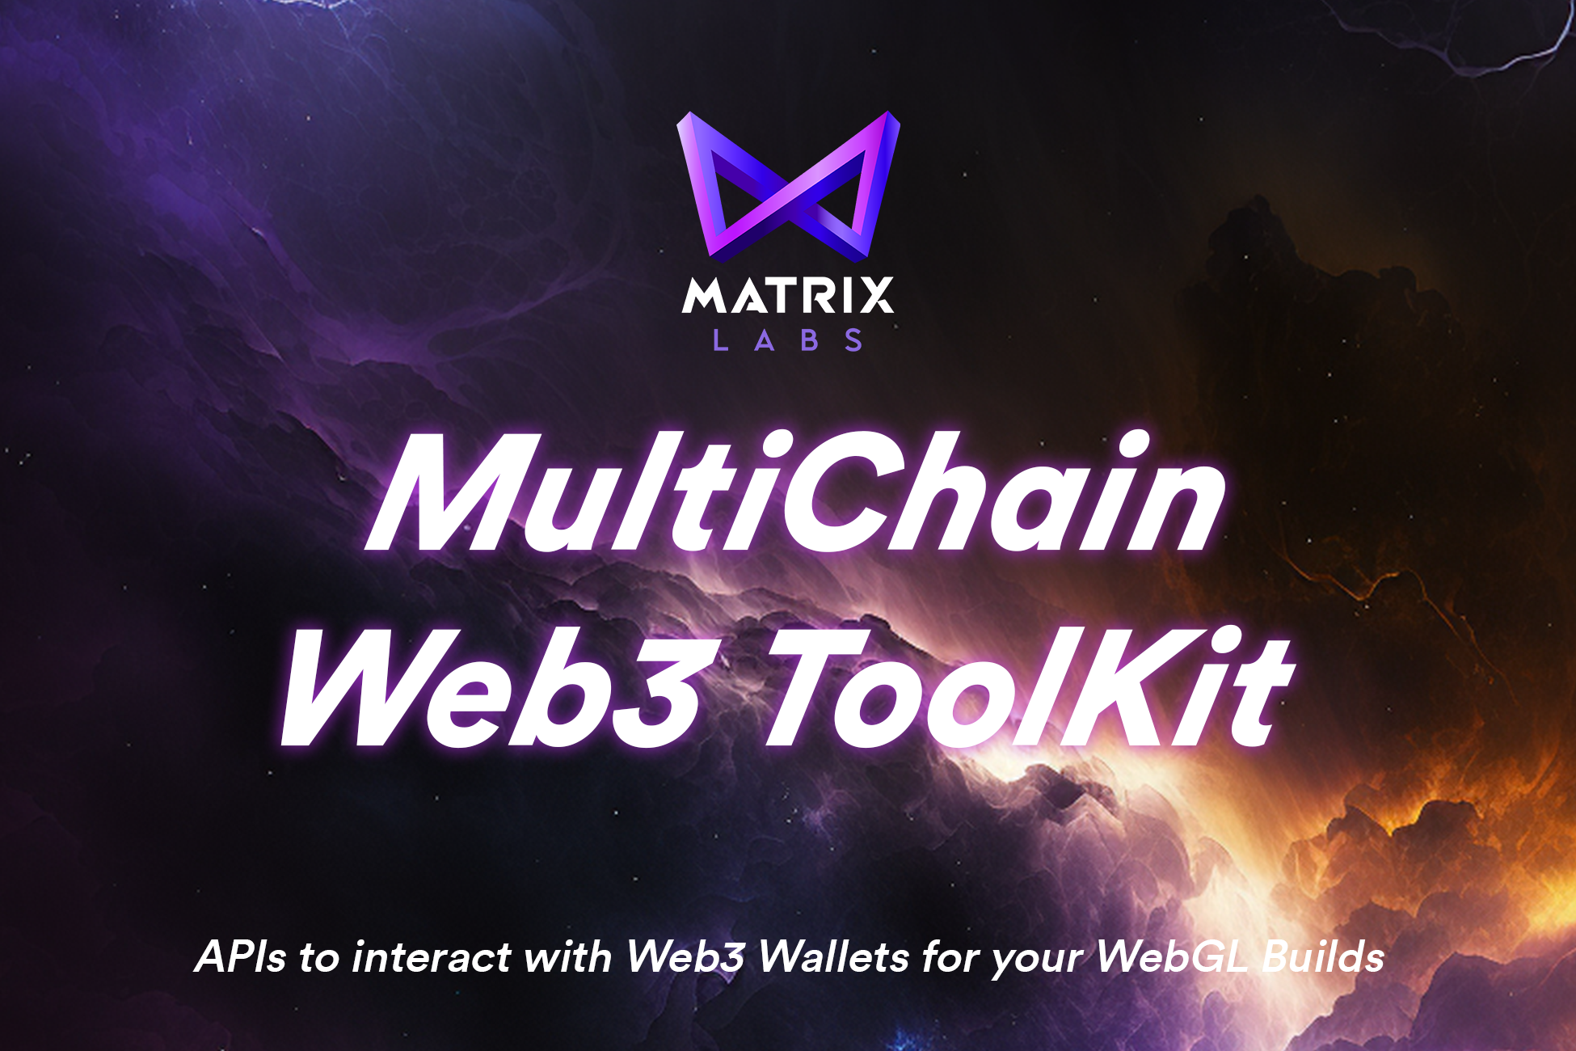
Custom
…
Limited Flexibility
Not truly multichain
Heavy dependencies
…others
Ease of Development
Advanced APIs, True Multichain, Ready to use!

Slide 4
Design
Multichain
APIs
UI Kit
Unity SDK
Customisable UI Kit
Multichain Web3 APIs
Wallet Sign In
Transactions & Interaction with Smart Contracts
Transaction Signing
Change Network / Chain
Async Events - Success & Error
React Client
Unity SDK
React Client

Slide 5
Development Flow

Slide 6
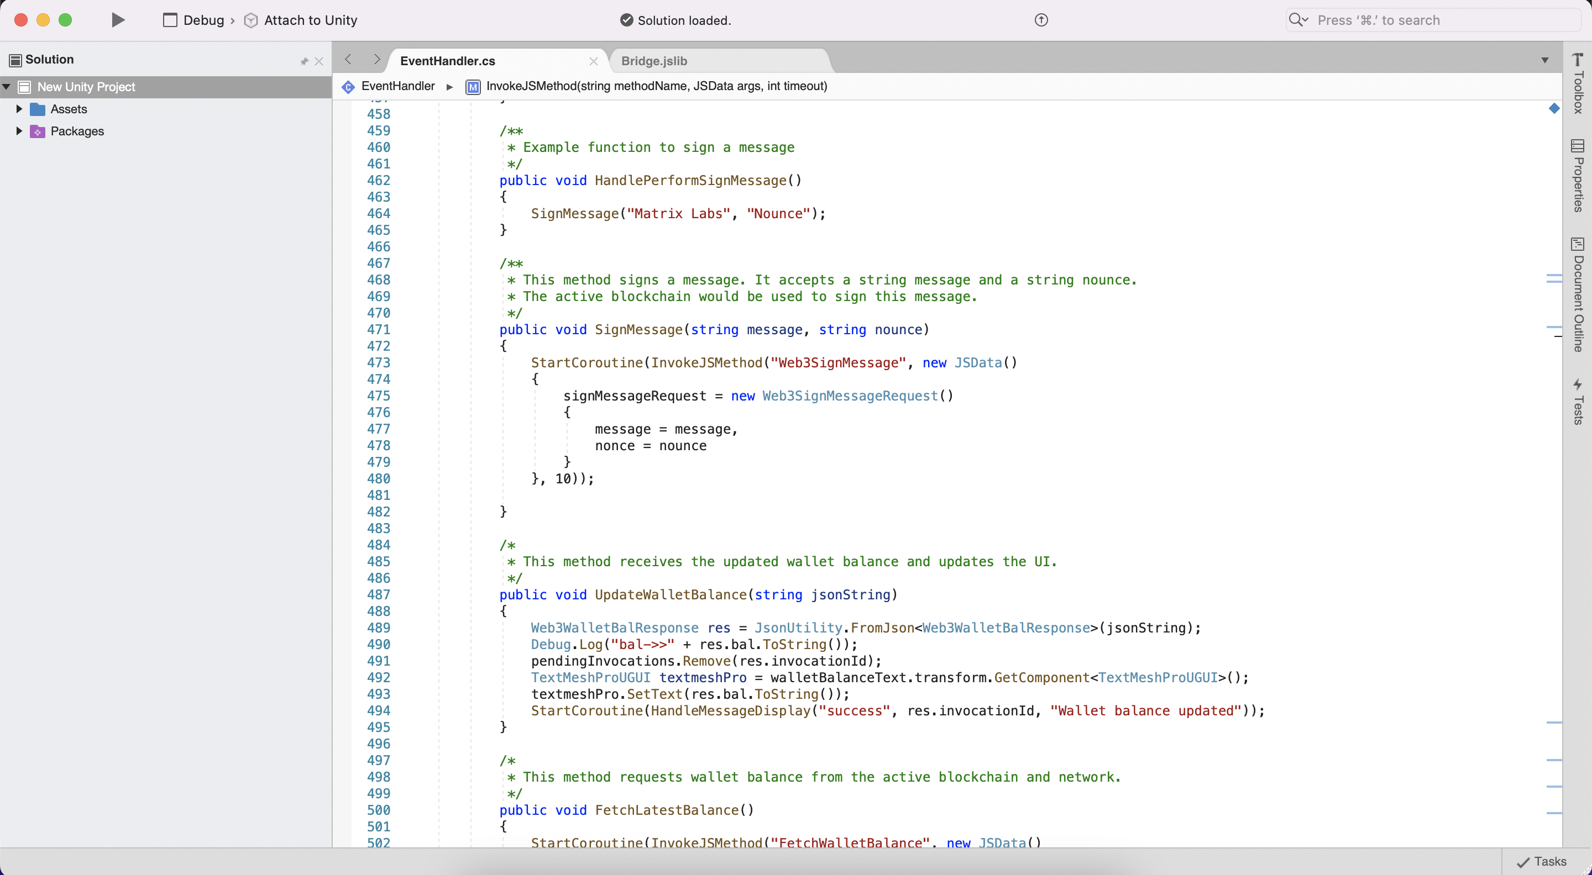
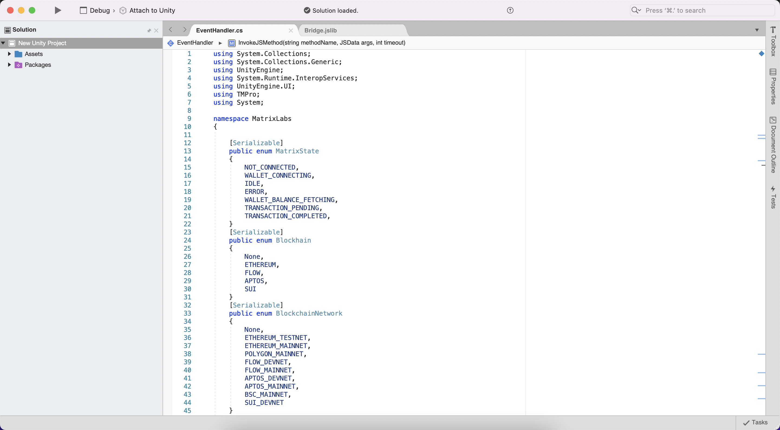
APIs
Custom namespaces, clean commented coding practices
Editable invokable functions
Easy to add new web3 APIs

Slide 7
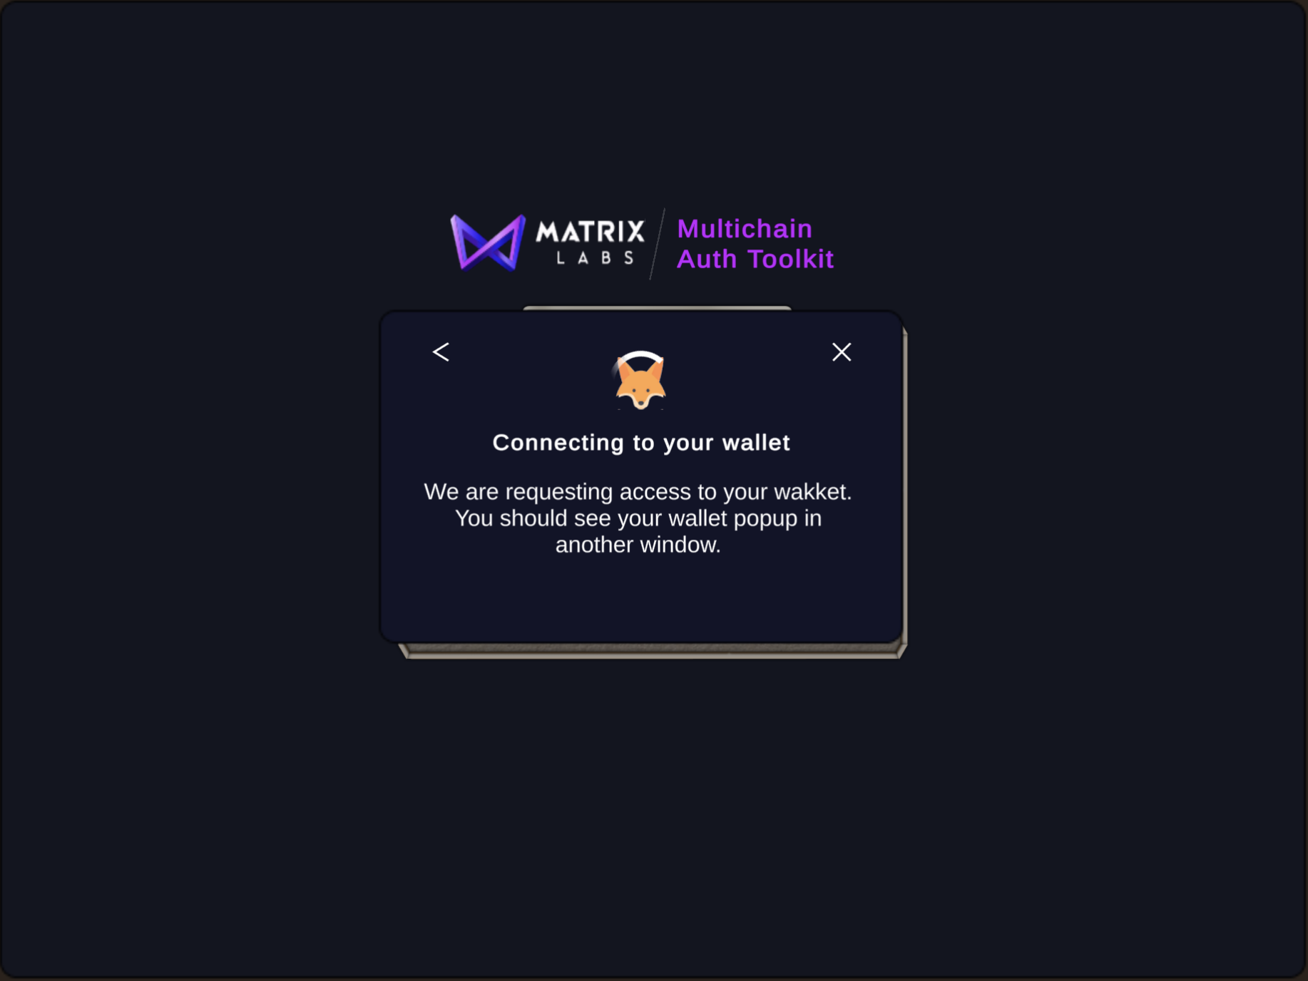
(Plug n’ Play) UI Kit!

Slide 8
Designed for multichain Web3 experience!
4 Wallets supported & Easy to integrate new wallets!

Slide 9
Thank you!

